Slide 1



Facility Process Flow of ART Patients
Victor Sumbi
Senior Technical Advisor
Management Sciences for Health (MSH)
Systems for Improved Access to Pharmaceuticals and Services (SIAPS)

Slide 2
Current Situation: Discussion
Main sites
How do you manage IMAI ART patients’ data and stocks?
What are the gaps, if any?
Is IMAI dispensing data entered in the EDT?
Are the patients IMAI sites indicated in the relevant field on the EDT?
If EDT is used, when is dispensing done; In advance (before the medicines are sent to the site)?
Does the pharmacy get to know of patients who did not show up for their ARVs? Are these ARVs returned to the pharmacy?
Adherence of patients at IMAI sites- is it calculated based on pill count?
Notes:
Have a flip chart at hand for this discussion
Discuss first then review the bullet points to see if everything was covered

Slide 3
Current Situation: Discussion (cont.)
IMAI sites
How do you manage IMAI ART patients’ data and stocks?
What record keeping documents do you use to manage your patients on ART
How do you decide how much ARVs to order?
Do you monitor adherence of your patients? How?
Do you dispense for >1 months’ supply?
What about patients on ART who show up unexpectedly at your site?
How often do you need to change your patients ART regimens? How do you coordinate this with pharmacy?
Other issues?
Notes:
Have a flip chart at hand for this discussion
Discuss first then review the bullet points to see if everything was covered

Slide 4
Processes
Do you initiate NEW patients on ART at your IMAI site? What is the process involved?
For EXISTING ART patients:
What is the quantity dispensed (1 month, 2 months etc)
Do you monitor and record their adherence? How?
Do you serve TRANSFERRED IN & IN TRANSIT patients? How?
Do you change ART regimens at your IMAI site? What is the process involved?
What information do you send to/ receive from the ART Main Site and how frequently? What reporting tools are used, if any?
How do you manage your ART stocks at IMAI site- do you use stock cards? How much quantity do you order?
Notes:
Have a flip chart at hand for this discussion
Discuss first then review the bullet points to see if everything was covered

Slide 5
How can we improve the system
Can we improve the current system to be able to provide accurate patient data (on-time pick up, patient status- LOST, LTFU etc., adherence information etc.) while reducing the workload for both Main Sites and IMAI Sites?
How?
Notes:
Record proposals on flip chart

Slide 6
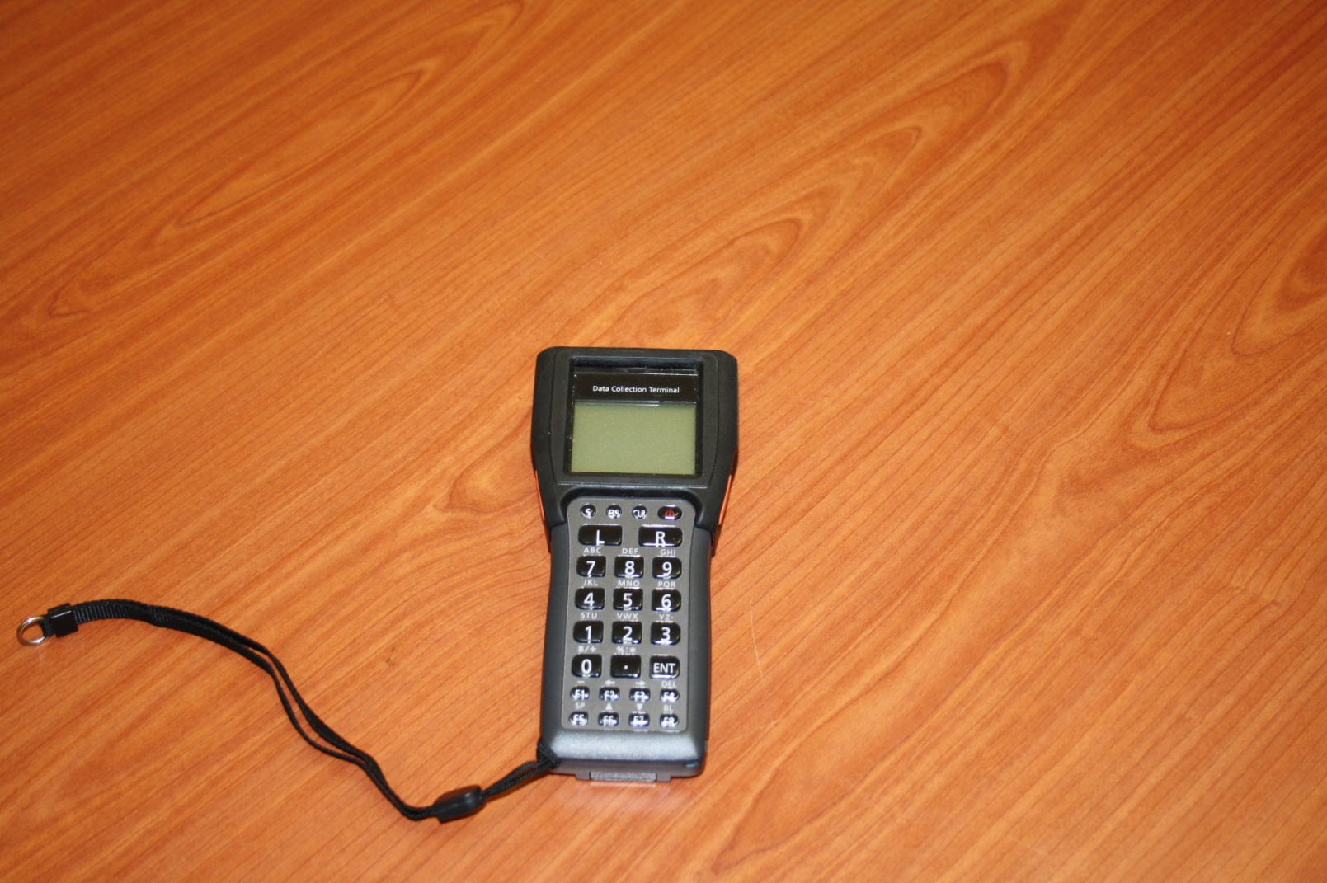
EDT Mobile

Slide 7
Proposed Process Flow
Review Poster

Slide 8
Proposed Process Flow: Discussions
What happens at:
The main sites?
The IMAI sites?
What is new?
At the main site?
At the IMAI sites?
The EDT mobile
The Appointment Lists generated automatically from the EDT (to replace existing manual records)
Is it feasible?
What adjustments are required to the proposed process flow, if any?

Slide 9
Thank You

